Slide 1
Future of Jobs
Most in-demand tech skills for 2022
Akhil Gupta
Tech @ Faballey

Slide 2

Happy New Year

Slide 3
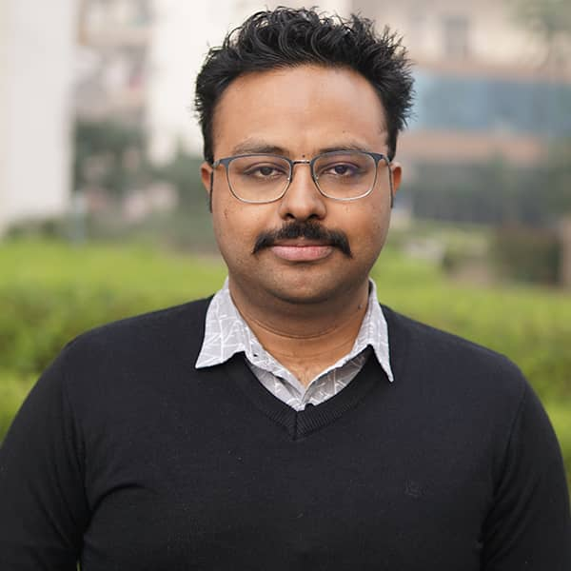
Akhil Gupta
Head technology at Faballey
15+ years in the field of Tech and Product
9+ years of entrepreneurial experience
Programming language polyglot
Prolific open source creator/contributor
Love to try new things (happy to fail)
Write @ https://akhil.me
Fun Fact - search “akhil bhangra” on YouTube.
Github - https://github.com/akhilrex
Twitter - @akhilrex
LinkedIn - https://www.linkedin.com/in/akhilrex

Slide 4
What to expect?
A lot of memes!
Opinionated
Actionable points
Twitter - @akhilrex
LinkedIn - https://www.linkedin.com/in/akhilrex

Slide 5

Presentation link
https://github.com/akhilrex/Future-of-Jobs-2022-webinar

Slide 6

Elephant in the room - COVID

Slide 7
What changed?
Last such massive change event – Industrial Revolution
No industry untouched – even Govt
Every one had to adopt WFH/Remote
Vaccination/Immunity will bring some back
But there will be lasting changes in the way work is done

Slide 8

The new “normal”

Slide 9
Real implications
No need to move to a hub (Bangalore, Silicon Valley)
If you are talented you can find opportunities anywhere
More opportunities
Especially for Women, Differently abled and people who were geographically limited for whatever reason
Wage normalisation
Maybe better work life balance

Slide 10

But!!!

Slide 11

Real-er implications
Usual career growth trajectory no longer applicable
Whole world is theoretically your competitor
Complacence is no longer an option
Constant upskilling is a necessity
Will have to bring more to the table
True for freshers and experienced alike

Slide 12
What skills to acquire then?
What’s hot? What will make my career secure? What will make my career future-proof? What is the right direction?
I have 5 recommendations for you.

Slide 13
#1 Good Old Software Development and Programming

Slide 14
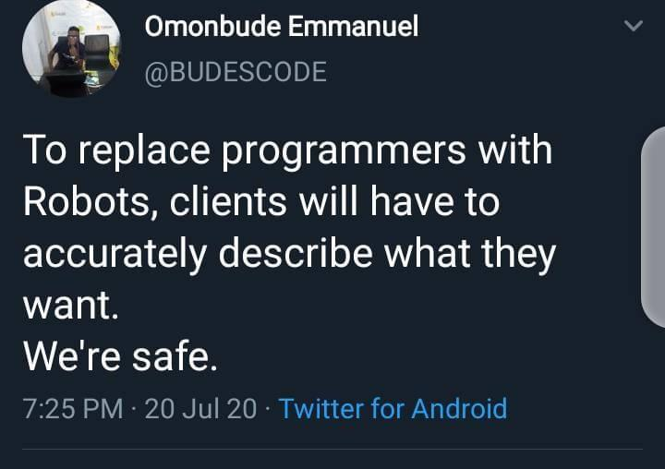
Programming jobs are not going anywhere.

Slide 15
Why this?
Despite being old and “boring” this is a high growth market.
Programming jobs to increase by 21% by 2028.
As internet adoption increases web and mobile apps need to be created to cater the needs
Great starting point for everyone which can later branch into management, individual contributor or even into areas like AI/ML, Blockchain and what not.
If you do not build a strong base, branching to new things will be difficult.

Slide 16
What you should do?
Get awesome at one thing. One programming language. One framework. Choose something and excel
Learning new languages then becomes about learning new syntax mostly.
Javascript – Can literally be used anywhere. Backend, frontend, Fullstack everywhere. Truly versatile. Learn Express for backend and React for frontend.
Python – Extremely powerful and a favourite in data and ML community
Flutter – Build cross platform (but mostly Android) apps.
Swift – iOS apps
Java, .Net – Classic. Safe. Always
Whatever rocks your boat.

Slide 17
How?
Go beyond Hello World and replicating blog post scenarios. This is like reading maths.
Build / Contribute to open source. People will use your product
Google, YouTube and StackOverflow are your friends.
Use paid services like Pluralsight.com (like Udemy but better)
Find a mentor

Slide 18
#2 Data Science (and AI/ML)

Slide 19

Hot!!

Slide 20
Why this?
Refers to scientific methods, tools, processes, and algorithms that are used to extract information and insights from structured and unstructured data
Hottest domain in tech right now with the best packages.
With a mobile in every hand the amount of data businesses are handling is unimaginable.
They need people to make sense of that data.
Good starting point for AI/ML

Slide 21
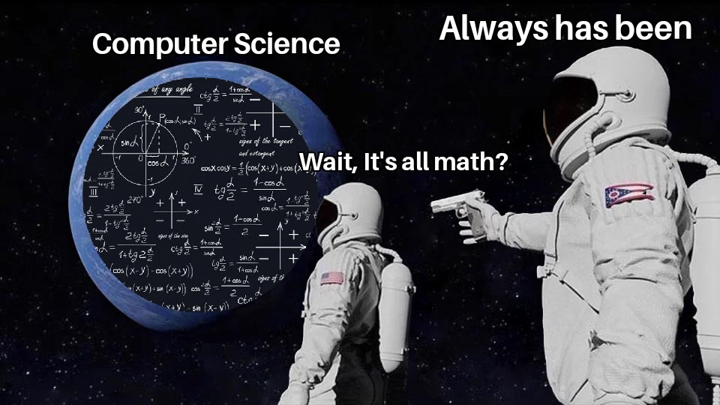
What you should do?
Learn Math. Really. Basically Statistics
Learn Python. R and Javascript are also good. But Python is the standard
Learn SQL – This is the de-facto format for querying data.
Learn Math. So important that needs to be repeated.
Identify, clean and enhance data.
Practice with real data.

Slide 22
How?
All resources as programming for Python, R, PyTorch, TensorFlow, Keras etc.
Google, YouTube and StackOverflow are your friends.
Use paid services like Pluralsight.com (like Udemy but better)
Practice with real data on Kaggle and Analytics Vidhya

Slide 23
Links
Machine Learning, Data Science, and Deep Learning with Python
Data Science: Machine Learning
HarvardX's Data Science Professional Certificate

Slide 24
#3 Cloud Computing

Slide 25
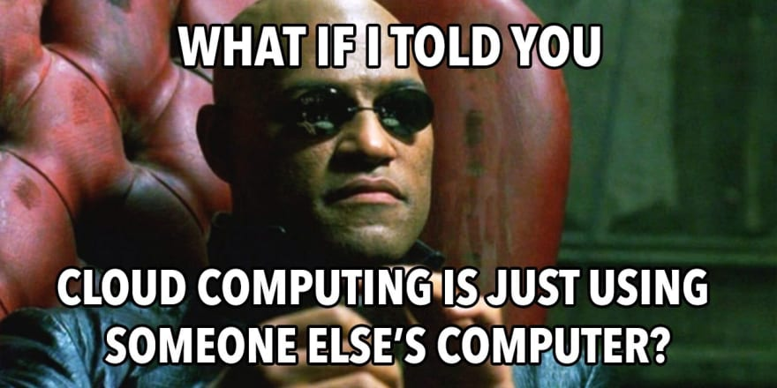

Slide 26
Why this?
Refers to storing and accessing computing services, such as databases, software, servers, networking, and analytics over the internet.Hottest domain in tech right now with the best packages.
Owning servers is so 20th century.
AWS, Azure and GCP running majority of the internet
High adoption which means high demand.
As products scale in terms of usage and complexity, so does the inherent infrastructure requirements.

Slide 27
What you should do?
Cover your basics – Networking, security and architecture.
Learn about specific offerings from each provider and decide which one to specialise in.
Practice with practical implementation – deployment, migrations, load balancing and scaling, storage, disaster recovery.
Official training and certifications.
I personally recommend AWS

Slide 28
How?
Nothing beats official documentation from AWS, GCP and Microsoft.
Google, YouTube and StackOverflow are your friends.
Use paid services like Pluralsight.com (like Udemy but better)

Slide 29
Links
Introduction to Cloud Computing with Amazon Web Services
Getting Started with Cloud Computing — Level 1
Cloud Computing Concepts by Coursera

Slide 30
#4 DevOps

Slide 31
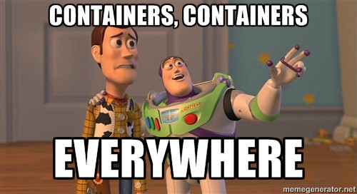
We can do this in docker!

Slide 32
Why this?
Refers to set of practices and tools that combine software development and IT operations to shorten the systems development life cycle. In simple terms, it aims to make the process of building, testing and releasing software – faster and more reliable.
Perfectly paired with Cloud adoption.
Not only limited to large organisations
Transition from Developer to DevOps is manageably easy

Slide 33
What you should do?
Have strong programming basics
Cover your basics – Version Control, Scripting, Continuous Integration and Deployment, Automated builds and tests
Learn different ways of software delivery and deployment – Architecture (microservices), Containerisation (Docker etc) and orchestration (Kubernetes)
Get a bunch of cheap computers, raspberry pis. Practice extensively on local setups to learn infra setup using tools like Ansible, Puppet etc.
Learn serverless

Slide 34
Links
Continuous Delivery & DevOps
Kubernetes: Getting Started
Getting Started with DevOps on AWS
Microsoft Certified: DevOps Engineer Expert

Slide 35
#5 Project Management

Slide 36
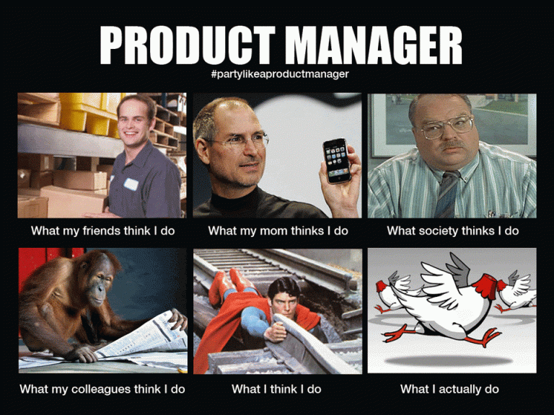
Perceptions!

Slide 37
Why this?
Always in demand. As projects grow in scale and size a dedicated product manager becomes a necessity.
Even more important role looking at how teams are now distributed.
Easy to transition from a developer role.
Constant and clear career growth
Easily transferrable skills

Slide 38
What you should do?
Build a strong base of understanding of SDLC and PM fundamentals- Agile, Scrum, Kanban etc
Improve communication skills – written and verbal
Learn to use tools like JIRA (project planning and execution), Asana, Trello etc.
Certifications to make it official
PMP certification – Most popular
PRINCE2 Certification

Slide 39
Links
Coursera: Fundamentals of Project Planning and Management
Simplilearn: PMP Certification Training Course
Prince2: 6th Edition Foundation Classroom

Slide 40
Special Mention
Blockchain and Crypto – More maths but capable of some really interesting implementations. Could be a great next step for many.
Learn Smart Contracts, Ethereum Blockchain
Beyond Cryptocurrency and NFTs
Cyber Security – Threats increasing on a day to day basis.
Industry certification – Security+, Network+ offered by CompTIA
AR/VR – From gaming to Metaverse, this is inevitable.
Networking – Old but gold

Slide 41
Action Plan
Get expert at at-least on thing.
Build. Don’t just study.
Get official certifications/degrees wherever possible – shine on resumes
Join Startups / Fastworking teams
Attend technology specific events and conferences – find peers and mentors
Cross skill upgradation – Learn Management and entrepreneurship
Give back to the community – write, teach or build open source

Slide 42
Presentation link
https://github.com/akhilrex/Future-of-Jobs-2022-webinar

Slide 43
This too shall pass.
@akhilrex
https://akhil.me

